Slide 1

Searching & Sorting Algorithms
Simple (selection) sort, bubble sort, insertion sort, quick sort.
Linear (Sequential) search, binary search
Chp 9 page 209

Slide 2
Tutorials for sorting and searching algorithms
Visual Representation of the Sorting Algorithms
https://visualgo.net/en/sorting
Video Tutorial – how not to forget the sorting and searching algorithms
https://www.youtube.com/watch?v=zuwBCImIyaw
Searching Algorithms
Linear Search
Binary Search
Sorting Algorithms
Insertion Sort
Bubble Sort
Simple (Selection) Sort
Quick Sort (HL)

Slide 3
Searching & Sorting Algorithms
Searching algorithms search something (such as a list) for a specific item to see if it is present
Sorting algorithms sort something (such as a list) so that all items in the list are in a particular order.
There are many more algorithms than those presented here

Slide 4
Linear Search
A linear search checks each item of the list in turn to see if it’s the correct one.
It stops when it either finds the item its looking for, or has checked every item in the list
Visual representation of the sorting algorithms

Slide 5
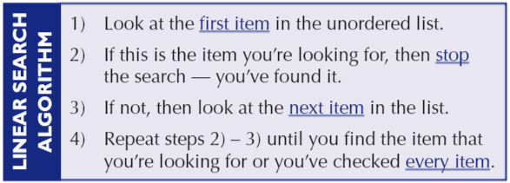
Linear Search

Slide 6
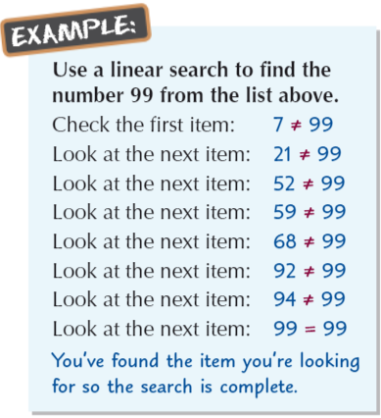
Linear Search

Slide 7
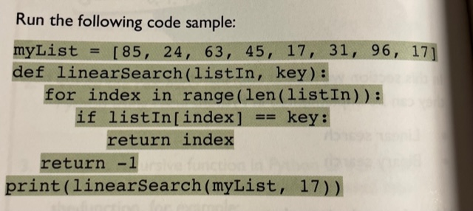
Linear Search Code
The function returns a -1 if no match was found. -1 is used because index -1 does not exist. This lets programmer know no key was found.
This code only returns the location of the index the first time the key was found.

Slide 8
Linear Search - Pros and Cons
Pros
Cons
Will perform fast searches of small to medium lists. With today's powerful computers, small to medium arrays can be searched relatively quickly.
The list does not need to sorted. Unlike a binary search, linear searching does not require an ordered list.
Not affected by insertions and deletions. As the linear search does not require the list to be sorted, additional elements can be added and deleted. As other searching algorithms may have to reorder the list after insertions or deletions, this may sometimes mean a linear search will be more efficient.
Slow searching of large lists. For example, when searching through a database of everyone in the Northern Ireland to find a particular name, it might be necessary to search through 1.8 million names before you found the one you wanted. This speed disadvantage is why other search methods have been developed.

Slide 9
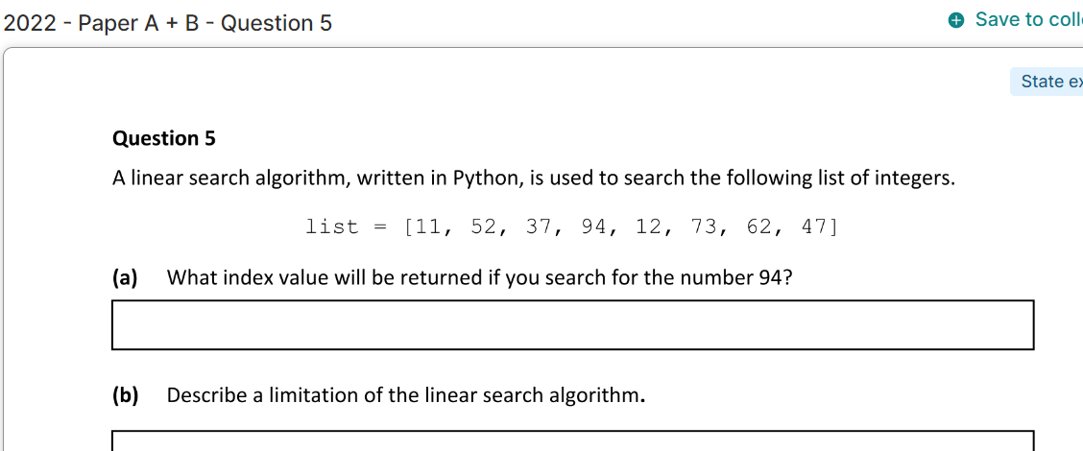
Exam Question (Ordinary)

Slide 10
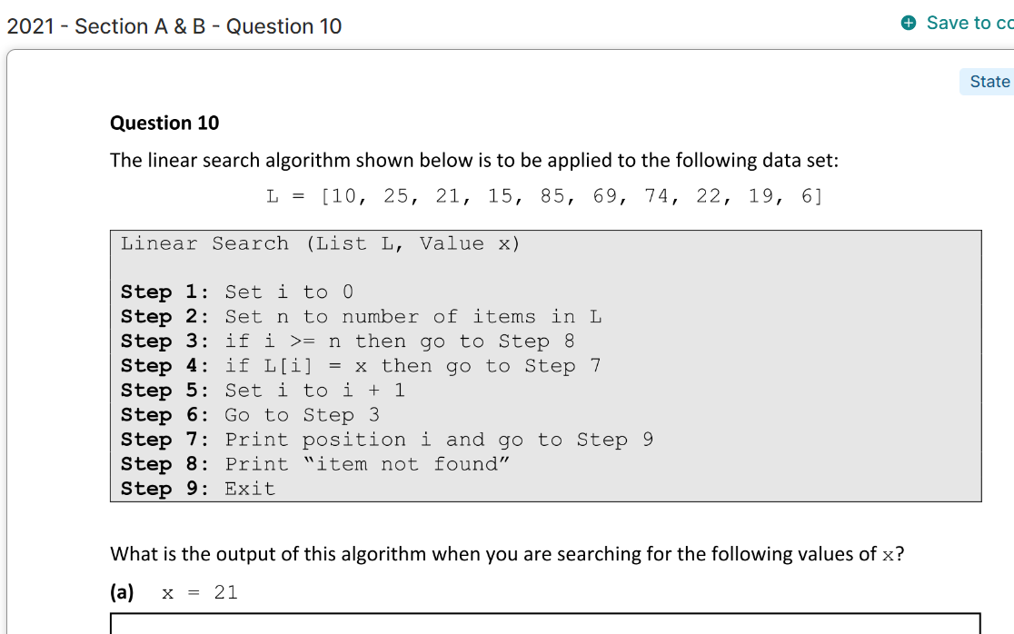
Exam Question (Ordinary)

Slide 11
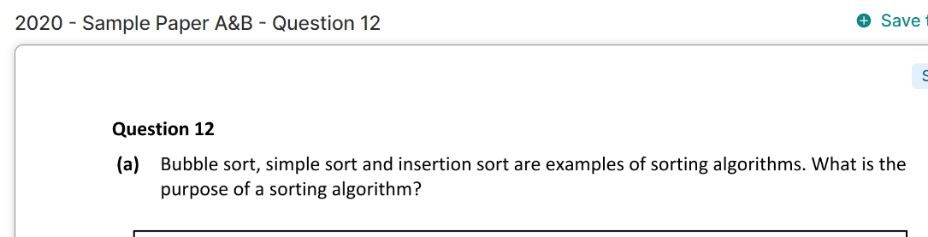
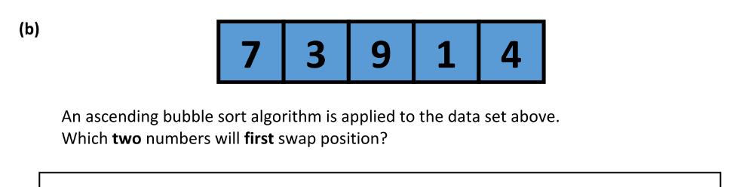
Exam Question (Ordinary)

Slide 12
Binary Search
A binary search differs from a linear search as it requires that the list is already sorted and takes advantage of this. We can use the built-in function .sort() for this
Binary search is known as “divide and conquer” algorithm where the problem in hand, is divided into smaller sub-problems and then each problem is solved independently

Slide 13
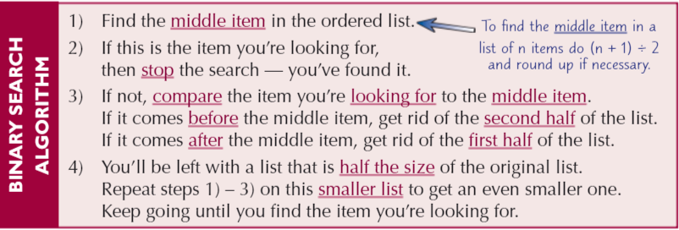
Binary Search

Slide 14
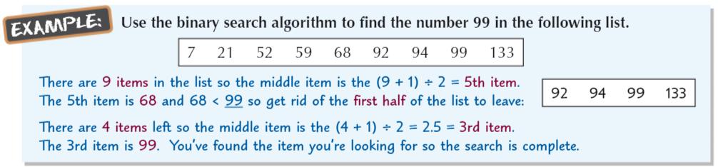
Binary Search

Slide 15
Binary Search Tutorial Video
https://www.youtube.com/watch?v=KXJSjte_OAI

Slide 16
Binary Search- Pros and Cons
Pros
Cons
One of the main advantages of a binary search is that it is much quicker than a linear search because the data that needs to be searched halves with each step. For example, it is possible to search through 1024 values and find the one you want within 10 steps, every time.
The biggest problem with a binary search is that you can only use this if the data is sorted into an order.

Slide 17
Linear Search vs Binary Search
A linear search is much simpler than a binary search, but not as efficient. A linear search can be used on any type of list. The list DOES NOT have to be ordered. Due to its inefficiency , a linear search is often only used on small lists.
Once the list has been ordered, a binary search is much more efficient than a linear search. A binary search takes fewer steps to find the item you’re looking for, making it more suitable for large lists of items

Slide 18
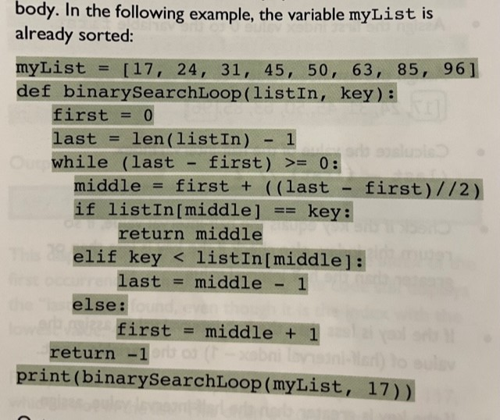
Code for the binary search

Slide 19
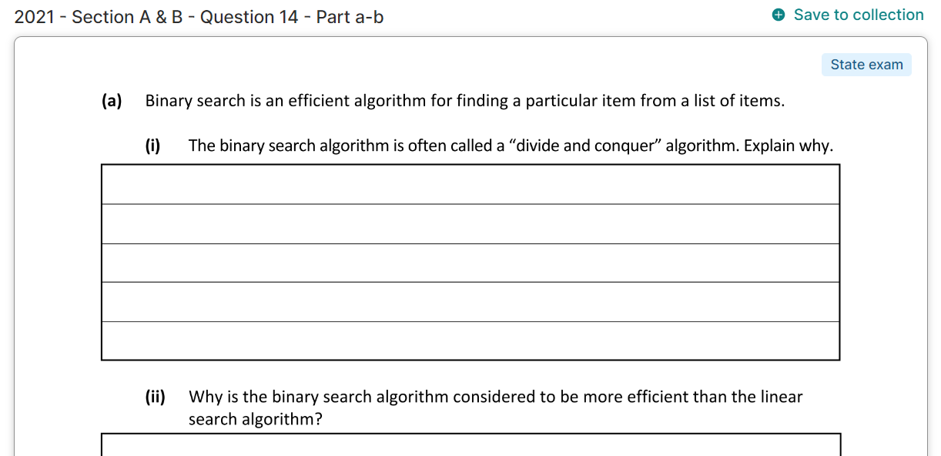
Exam Question (Ordinary)

Slide 20
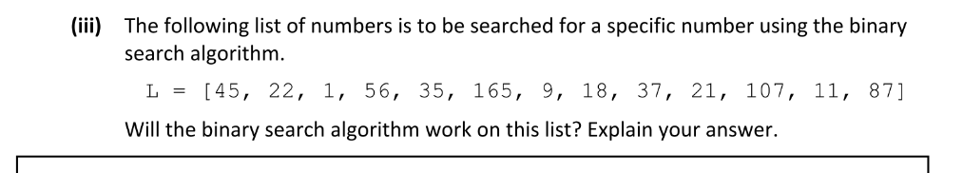
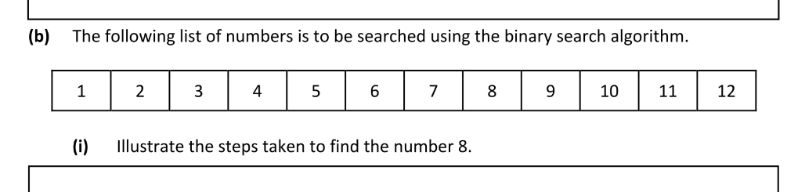
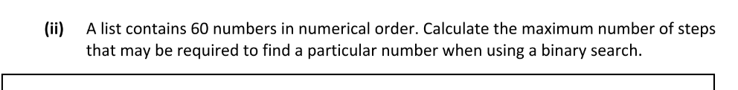
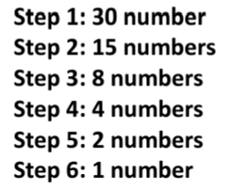
Exam Question (Ordinary)
Divide the list by 2 each time

Slide 21
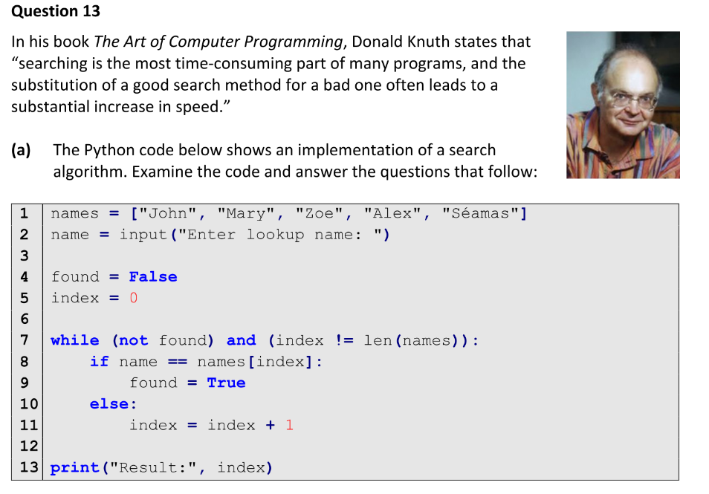
Exam Question (Higher 2020 Q13)

Slide 22
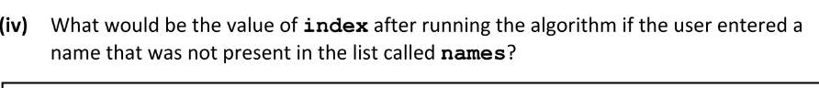
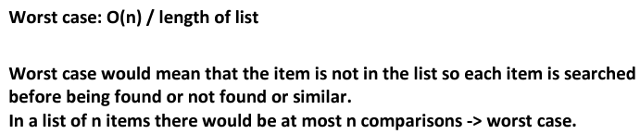
Exam Question (Higher 2020 Q13)

Slide 23
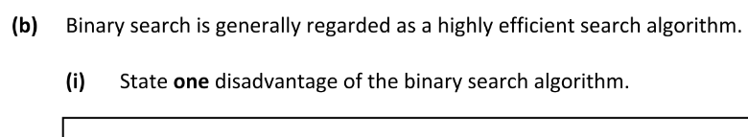
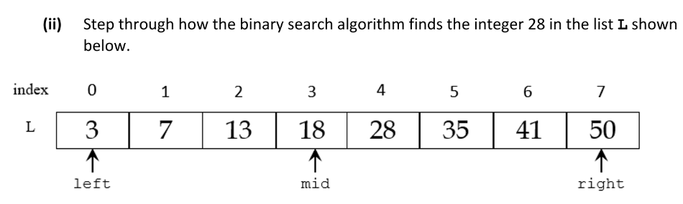
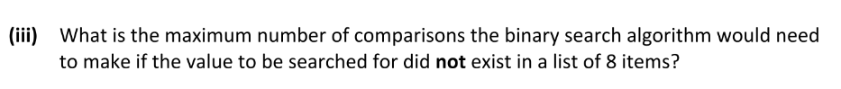
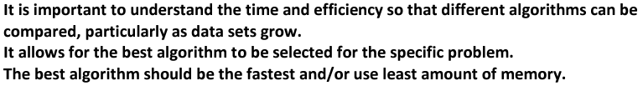
Exam Question (Higher 2020 Q13)

Slide 24
SORTING ALGORITHMS
For leaving cert you will need to know these 4 sorts:
Insertion Sort
Simple Sort also known as Selection Sort
Bubble Sort
Quicksort (Higher Level only)

Slide 25
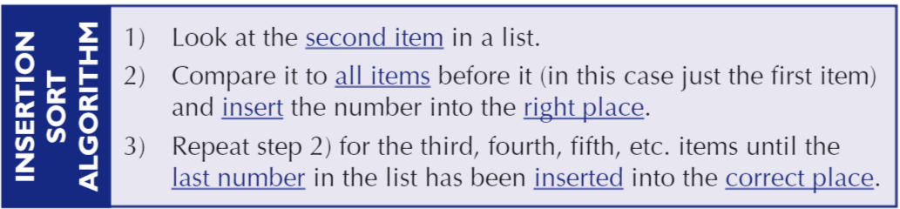
Sorting Algorithms – Insertion Sort
This is the simplest sorting algorithm to understand. It takes each item in turn and puts it in the correct place using the first item in the list as the starting point.
This is an in-place comparison-based sorting algorithm. This means all sorting done on original list, it doesn’t require much additional memory

Slide 26
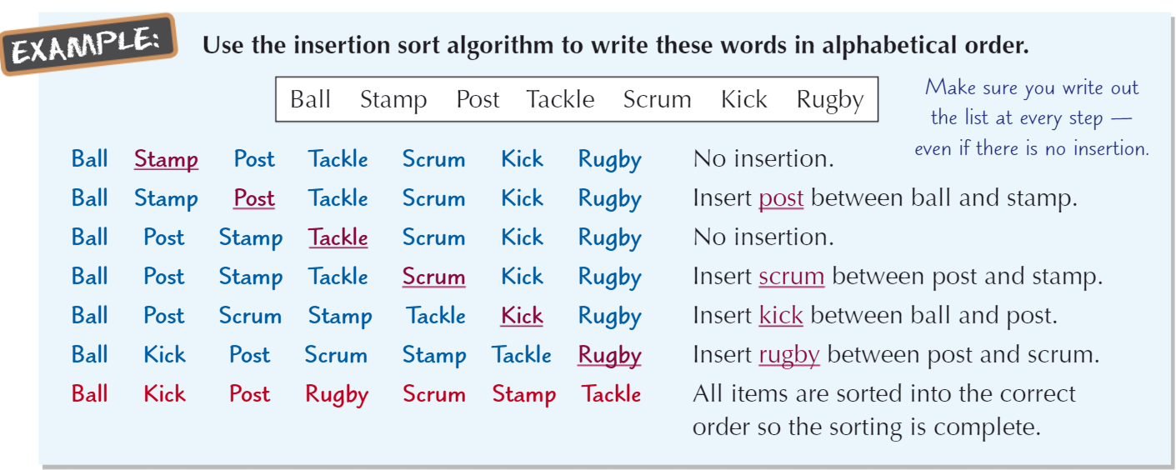
Insertion Sort Example

Slide 27
Insertion Sort - Pros and Cons
Pros
Cons
Intuitive way to sort the list and easy to code
Copes very well with small lists
All sorting done on original list, so like bubble sort, it doesn’t require much additional memory
Very quick to add items to already ordered list
Very quick way to check if list is already sorted
Similar to bubble sort, it doesn’t work well with very large lists
Best case scenario (when list is already sorted) requires n-1 comparisons
Worst case scenario requires n(n-1)/2 comparisons

Slide 28
The Insertion Sort – Video Tutorial
https://www.youtube.com/watch?v=OGzPmgsI-pQ

Slide 29
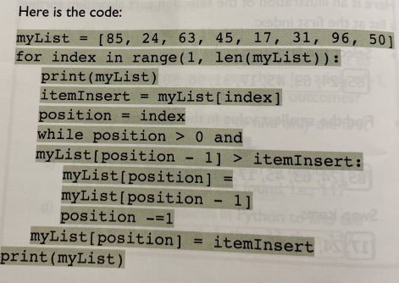
The Insertion Sort – The Code

Slide 30
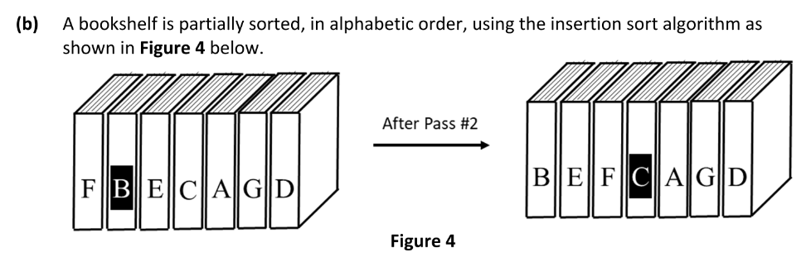
Exam Questions – Higher Level

Slide 31
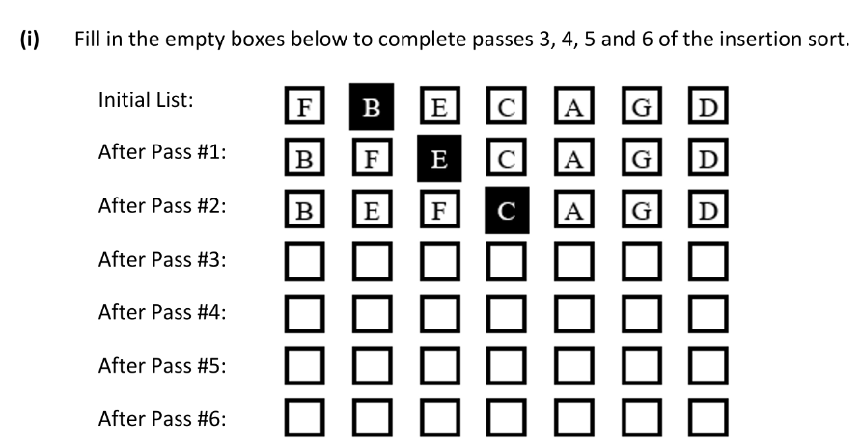
Exam Questions – Higher Level

Slide 32
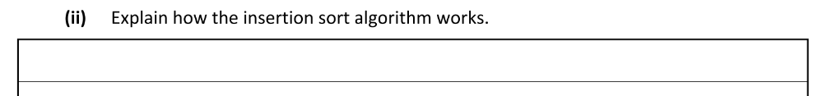
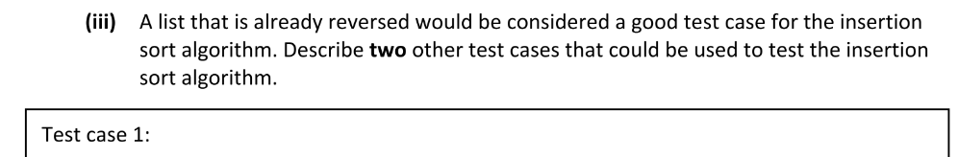
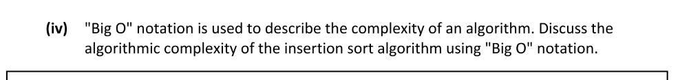
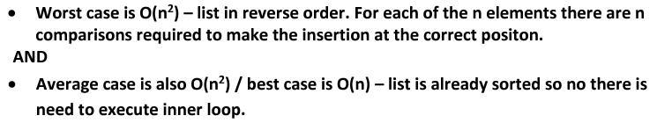
Exam Questions – Higher Level

Slide 33
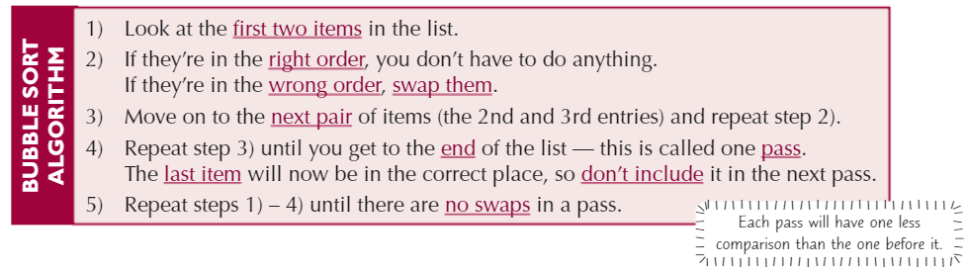
The Bubble Sort
A bubble sort compares pairs of items
The bubble sort algorithm is used to sort an unordered list of items.
The algorithm is very simple to follow but can take a while to sort the list.

Slide 34
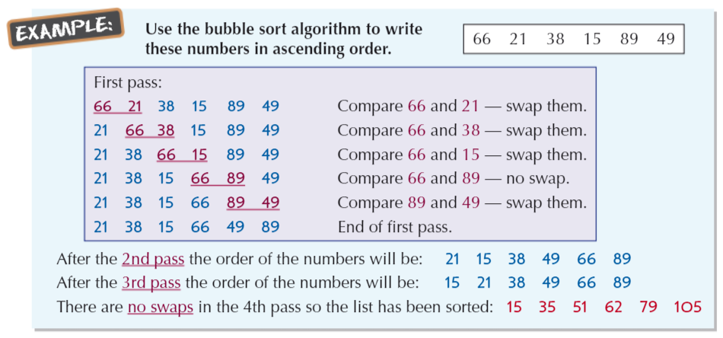
Bubble Sort Example

Slide 35
The Bubble Sort
Pros
Cons
It’s a simple algorithm that is easy to implement
It’s an efficient way to check if a list is already in order. For a list of n items you only have to do one pass of (n-1) comparisons to check if the list is ordered or not.
This is an in-place comparison-based sorting algorithm. This means all sorting done on original list, it doesn’t require much additional memory
It’s an inefficient way to sort a list – for a list of n items, the worse case scenario would involve you doing n(n-1)/2 comparisons.
Due to being inefficient, the bubble sort algorithm does not cope well with a very large list of items.

Slide 36
The Bubble Sort - Mistakes Students Make
A common mistake is to forget the final pass because you realise that the list is already in order. Always show a pass, even if nothing changes to complete the algorithm as a computer would
Video Tutorial for Bubble Sort
https://www.youtube.com/watch?v=WaNLJf8xzC4

Slide 37
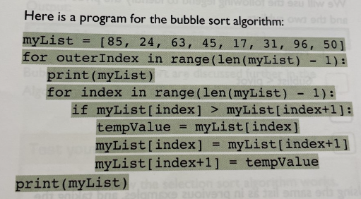
The Bubble Sort – The Code

Slide 38
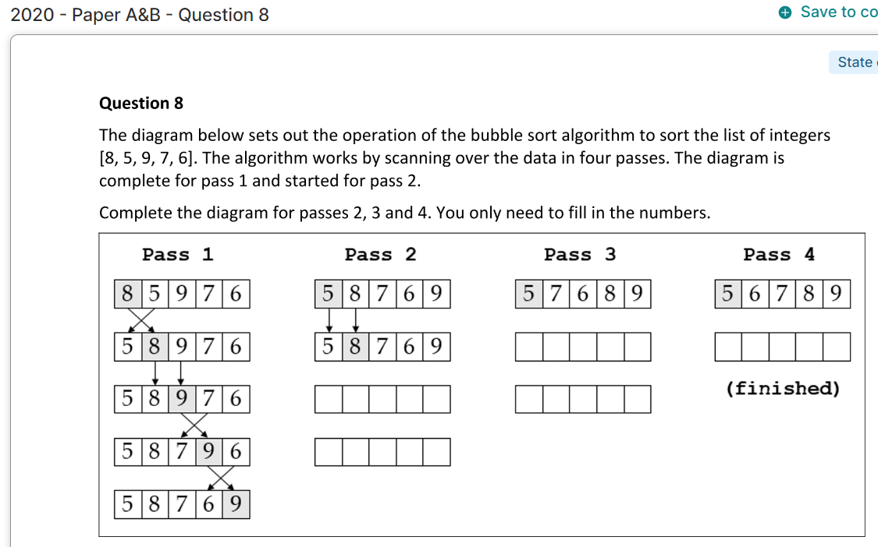
Exam Question _ Higher Level

Slide 39
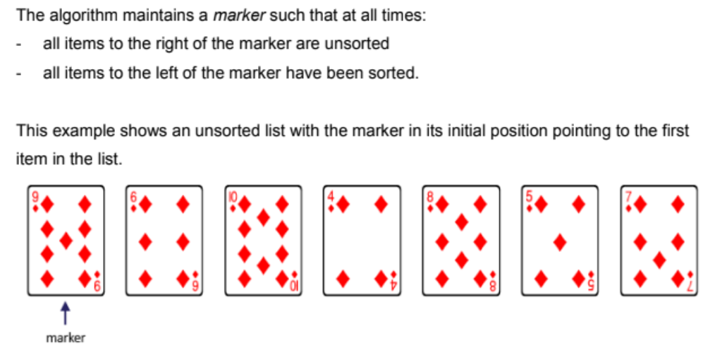
Simple or Selection Sort

Slide 40
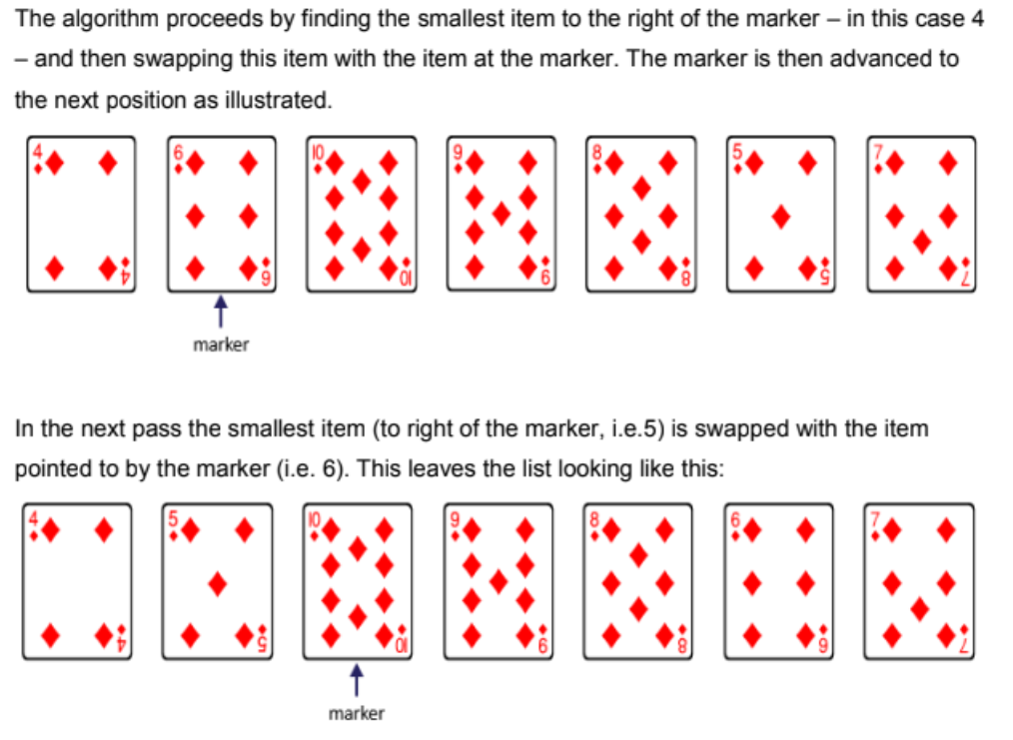
Simple or Selection Sort

Slide 41
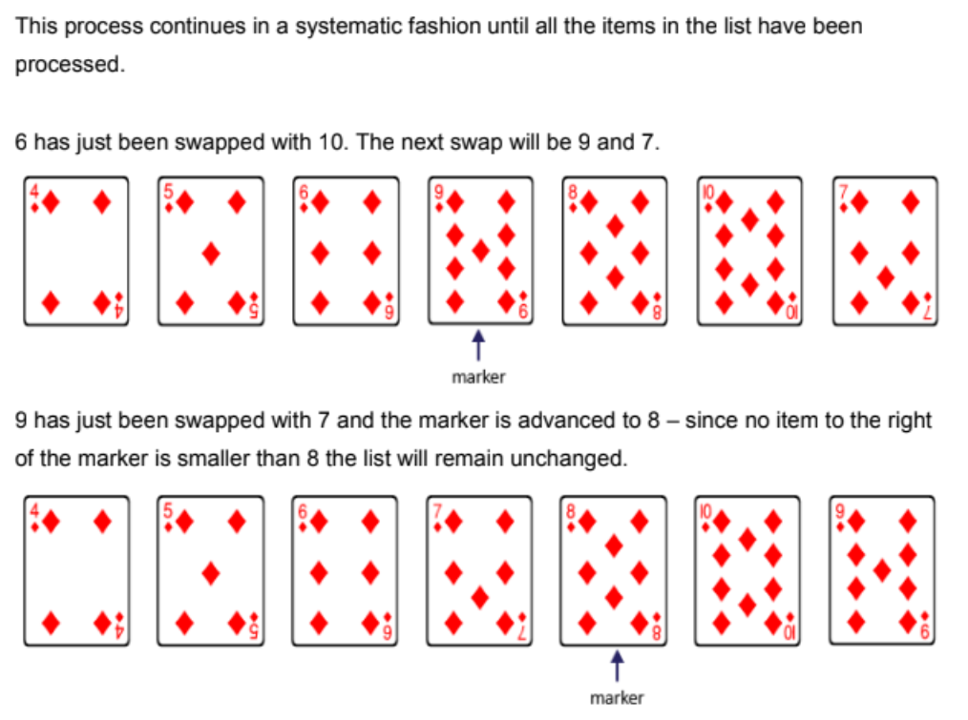
Simple or Selection Sort

Slide 42
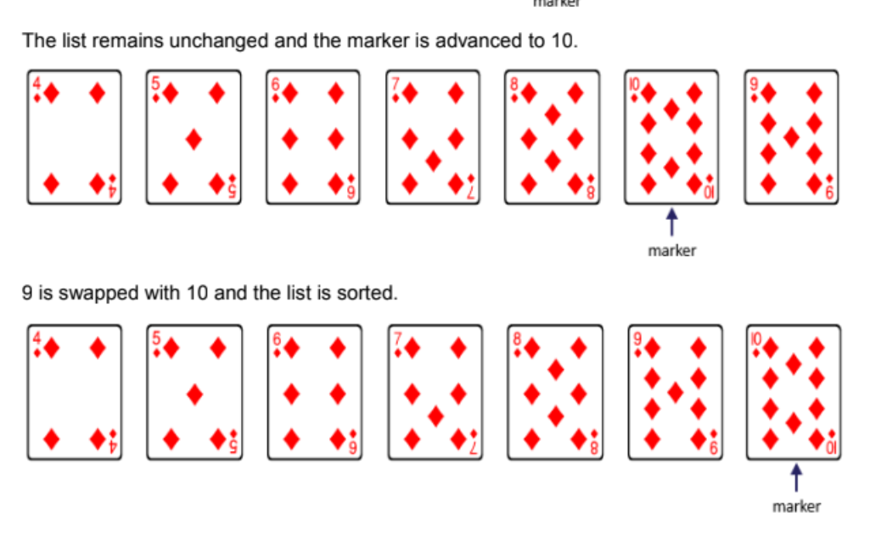
Simple or Selection Sort

Slide 43
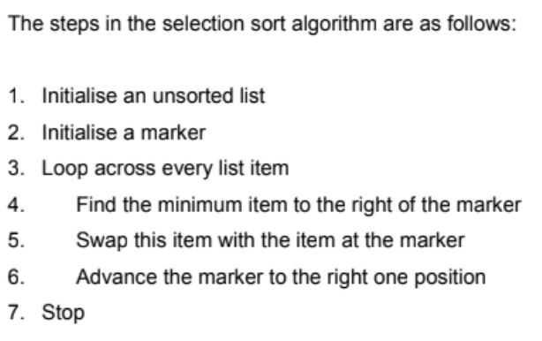
Simple or Selection Sort Algorithm

Slide 44
The Selection Sort
Pros
Cons
The main advantage of the selection sort is that it performs well on a small list.
It is an in-place sorting algorithm, so no additional temporary storage is required beyond what is needed to hold the original list
The primary disadvantage of the selection sort is its poor efficiency when dealing with a huge list of items.
The selection sort requires n-squared number of steps for sorting n elements.
Its performance is easily influenced by the initial ordering of the items before the sorting process. Because of this, the selection sort is only suitable for a list of few elements that are in random order.

Slide 45
Simple or Selection Sort – Video Tutorial
https://www.youtube.com/watch?v=xWBP4lzkoyM

Slide 46
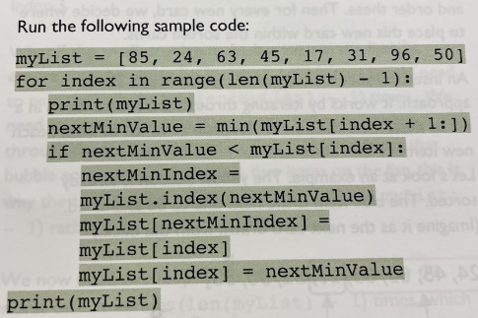
Simple or Selection Sort – The Code

Slide 47
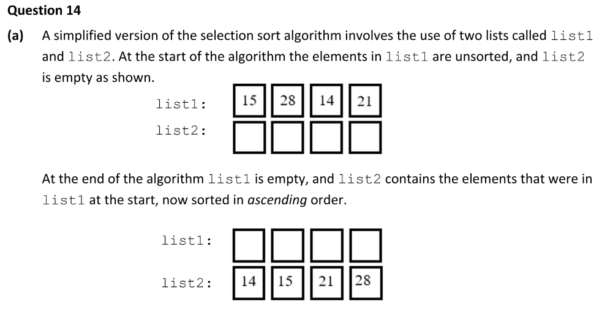
Exam Questions – Higher Level 2022 - Paper A + B - Question 14

Slide 48
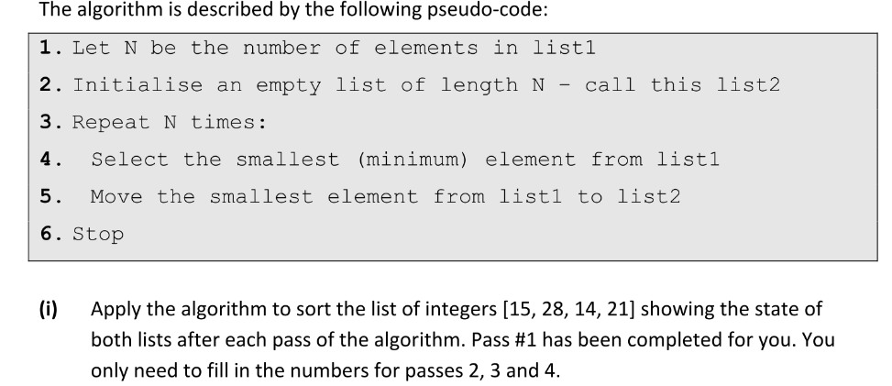
Exam Questions – Higher Level

Slide 49
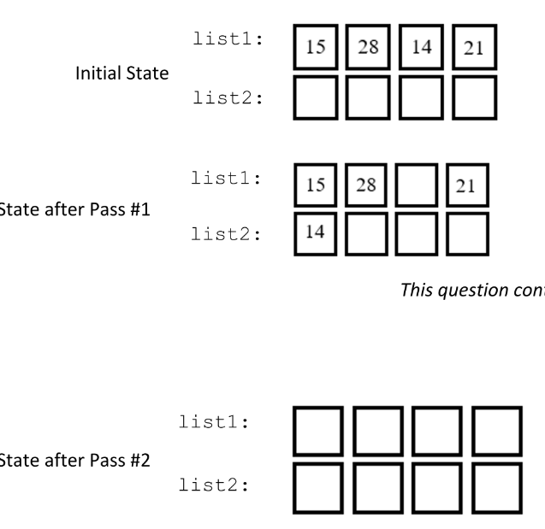
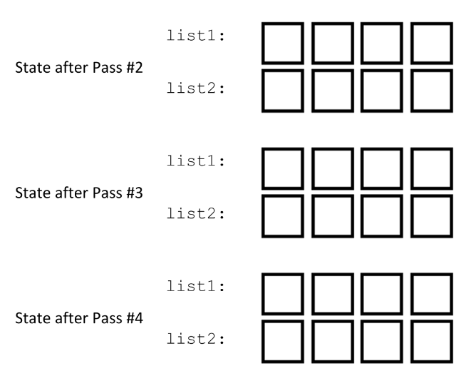
Exam Questions – Higher Level

Slide 50
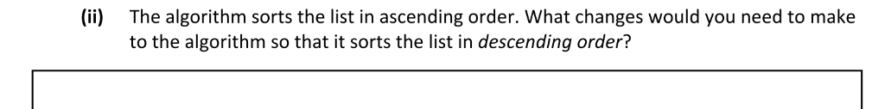
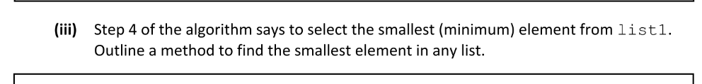
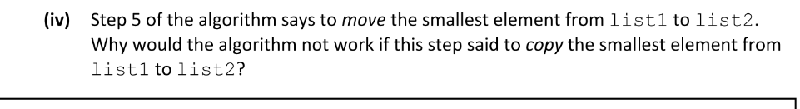
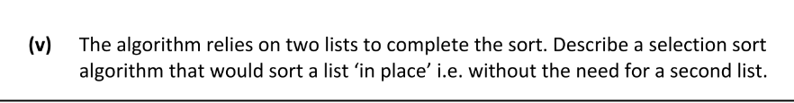
Exam Questions – Higher Level

Slide 51
Quick Sort (Higher Level)
QuickSort is a Divide and Conquer algorithm. A divide-and-conquer algorithm recursively breaks down a problem into two or more sub-problems, until these become simple enough to be solved directly
It picks an element as a pivot and partitions the given array around the picked pivot. There are many different versions of quickSort that pick pivot in different ways.
Always pick the first element as a pivot.
Always pick the last element as a pivot
Pick a random element as a pivot.
Pick median as the pivot.

Slide 52
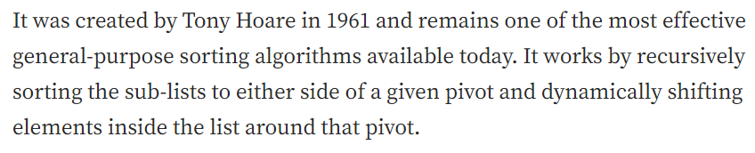
Quick Sort (Higher Level)
https://www.youtube.com/watch?v=h8eyY7dIiN4
https://towardsdatascience.com/an-overview-of-quicksort-algorithm-b9144e314a72

Slide 53

Quick Sort (Higher Level)

Slide 54


Quick Sort (Higher Level)
The quicksort algorithm can be implemented recursively (it calls itself and works on a subset of the problem until a specific point is reached).

Slide 55

Quick Sort (Higher Level)
The quicksort algorithm can be implemented recursively (it calls itself and works on a subset of the problem until a specific point is reached).

Slide 56

Quick Sort (Higher Level)
The quicksort algorithm can be implemented recursively (it calls itself and works on a subset of the problem until a specific point is reached).

Slide 57

Quick Sort (Higher Level)
The quicksort algorithm can be implemented recursively (it calls itself and works on a subset of the problem until a specific point is reached).

Slide 58
The Quick Sort
Pros
Cons
The quick sort is regarded as the best sorting algorithm.
Its significant advantage in terms of efficiency because it is able to deal well with a huge list of items.
It is an in-place sorting algorithm so no additional storage is required as well.
The slight disadvantage of quick sort is that its worst-case performance is similar to average performances of the bubble, insertion or selections sorts.
Difficult to implement due to the recursion
In general, the quick sort produces the most effective and widely used method of sorting a list of any item size.

Slide 59

The Quick Sort – The Code

Slide 60

Exam Questions – Higher Level - 2020 - Sample Paper A&B - Question 15
The worst case occurs when the picked pivot is always an extreme (smallest or largest) element. This happens when input array is sorted or reverse sorted and either first or last element is picked as pivot. This first results in 2 sublists: one of length (0) and one of length (n-1). The pivot value then needs to be compared with all (n-1) of the other values. If you pick the worst pivot on each recursion, you'll only have one group to sort, with everything in that group other than the original pivot that you picked. This in essence gives you n groups that each need to be iterated through n times, hence the O(n^2) complexity

Slide 61

Exam Questions – Higher Level

Slide 62
Exam Questions – Higher Level

Slide 63
Algorithms Time Complexity (HL)
Sometimes there are more than one algorithm to solve a problem. e.g.
You learned 2 searching algorithm: Linear & Binary
You learned 4 sorting algorithms: Insertion, Bubble, Selection, Quicksort
Algorithmic Complexity is an important area in computing. Algorithmic Complexity is a measure of how long an algorithm would take to complete, given an input size of n.
Big O notation is used to describe algorithmic complexity

Slide 64
Algorithmic Time Complexity (HL)
https://www.youtube.com/watch?v=RGuJga2Gl_k

Slide 65

Big O – Algorithmic Complexity

Slide 66

Big O – Algorithmic Complexity

Slide 67

Big O – Algorithmic Complexity

Slide 68
Intractable Problems and Heuristics - HL
There are many simple but important problems that are considered to be intractable i.e. no algorithms can solve them in a reasonable amount of time
One such problem is the travelling salesperson problem. A travelling salesperson needs to visit n towns. The sales person starts at one of the towns. The distance between each of the towns is known. The problem is : which route, visiting all the towns, then returning back to the starting point, covers the least distance?

Slide 69
Intractable Problems and Heuristics - HL
The travelling salesperson problem is very similar to many real life problems involving planning, deliveries etc.
There is no known algorithm to solve this problem exactly, in an efficient way, even for a relatively small number of towns.
The straightforward solution of just trying all the available options turns out to be O(n!) . Even with just 30 towns that ends up with 265252859812191058636308480000000 combinations. The fastest computer would require many millions of years to check all of these.

Slide 70
Intractable Problems and Heuristics - HL
What can be done with problems such as the travelling salesperson. Heuristic algorithms are one solution. A heuristic algorithm is not guaranteed to return the exact answer, but one that is sufficient.
A Heuristic algorithm allows us to produce an approximate, but useable solution to the problem.
Using heuristics with problems to be solved by the computer involves making a small change that sacrifices something e.g. accuracy or precision, in order to reduce the time taken to complete the algorithm.

Slide 71
Intractable Problems and Heuristics - HL
By using heuristics, sometimes the problem is changed slightly. This can produce a solution that is close enough to that of the original to be acceptable.
It is possible to mathematically guarantee that the solution to the problem found using heuristics is within some close limit of the original problem’s answer.
Many heuristic algorithms written for the travelling salesman problem are estimated to be within a 5% degree of accuracy of the original answer.

Slide 72

The Travelling Salesman Problem

